Slide 1
Information System Design
ISD Models
Notes:
Lecture# 19
24/10/2007
IT60105: D. Samanta, SIT, IIT Kharagpur

Slide 2
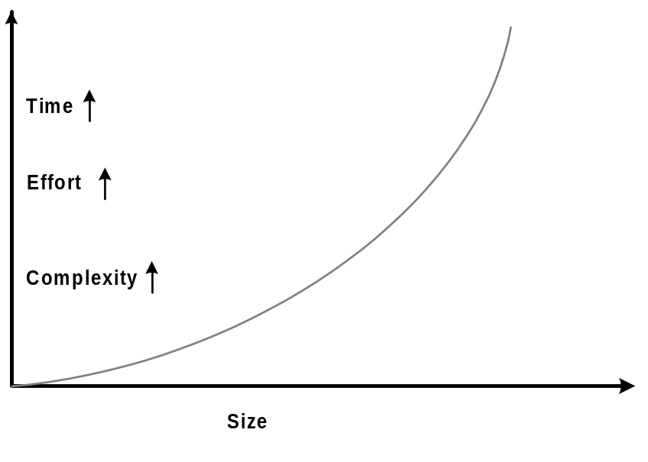
Why Planning Information System Design?
Program vs. Software
  Size (small/big)
  Effort (Individual/Team)
  Application and user
  Reliability (testing)
  Documentation (manual)
Technological growth
  Hardware
  Software
  Communication
IT based society
Information System Design
Notes:
Lecture# 19
24/10/2007
IT60105: D. Samanta, SIT, IIT Kharagpur

Slide 3
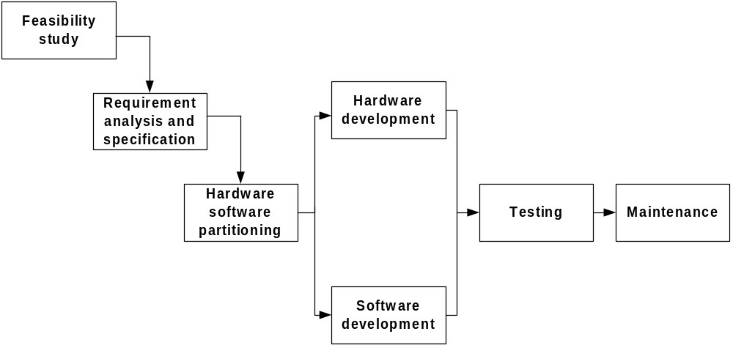
ISD Engineering
Information System Design
Notes:
Lecture# 19
24/10/2007
IT60105: D. Samanta, SIT, IIT Kharagpur

Slide 4
Development Models
Software Design Life Cycles
  Classical Waterfall Model
  Iterative Waterfall Model
  Prototyping Model
  Evolutionary Model
  Spiral Model
  Time-boxing model
  Rapid Application Development
  Component-based Software Engineering
  Agile process model
  RUP process model
Information System Design
Notes:
Lecture# 19
24/10/2007
IT60105: D. Samanta, SIT, IIT Kharagpur

Slide 5
System Design Life Cycle
A system design life cycle is a process consists of set of methodologies (activities) beginning from system inception through delivery and retirement
Basic activities in a system design life cycle are:
  Feasibility study
  Requirement analysis and specification
  Design
  Coding
  Testing
  Maintenance
An activity is also alternatively termed as a life cycle phase
Number of life cycle models are known to system designers
  All models are same so far the basic activities are concerned
  Models are different so far the order of activities are concerned
Information System Design
Notes:
Lecture# 19
24/10/2007
IT60105: D. Samanta, SIT, IIT Kharagpur

Slide 6
Why a Life Cycle Model?
It encourages development of system in systematic and disciplined manner
Provides better understanding and communication among team members
Pipelining the activities to carried out number of dissimilar projects together
Better utilization of resources (human + system)
Information System Design
Notes:
Lecture# 19
24/10/2007
IT60105: D. Samanta, SIT, IIT Kharagpur

Slide 7
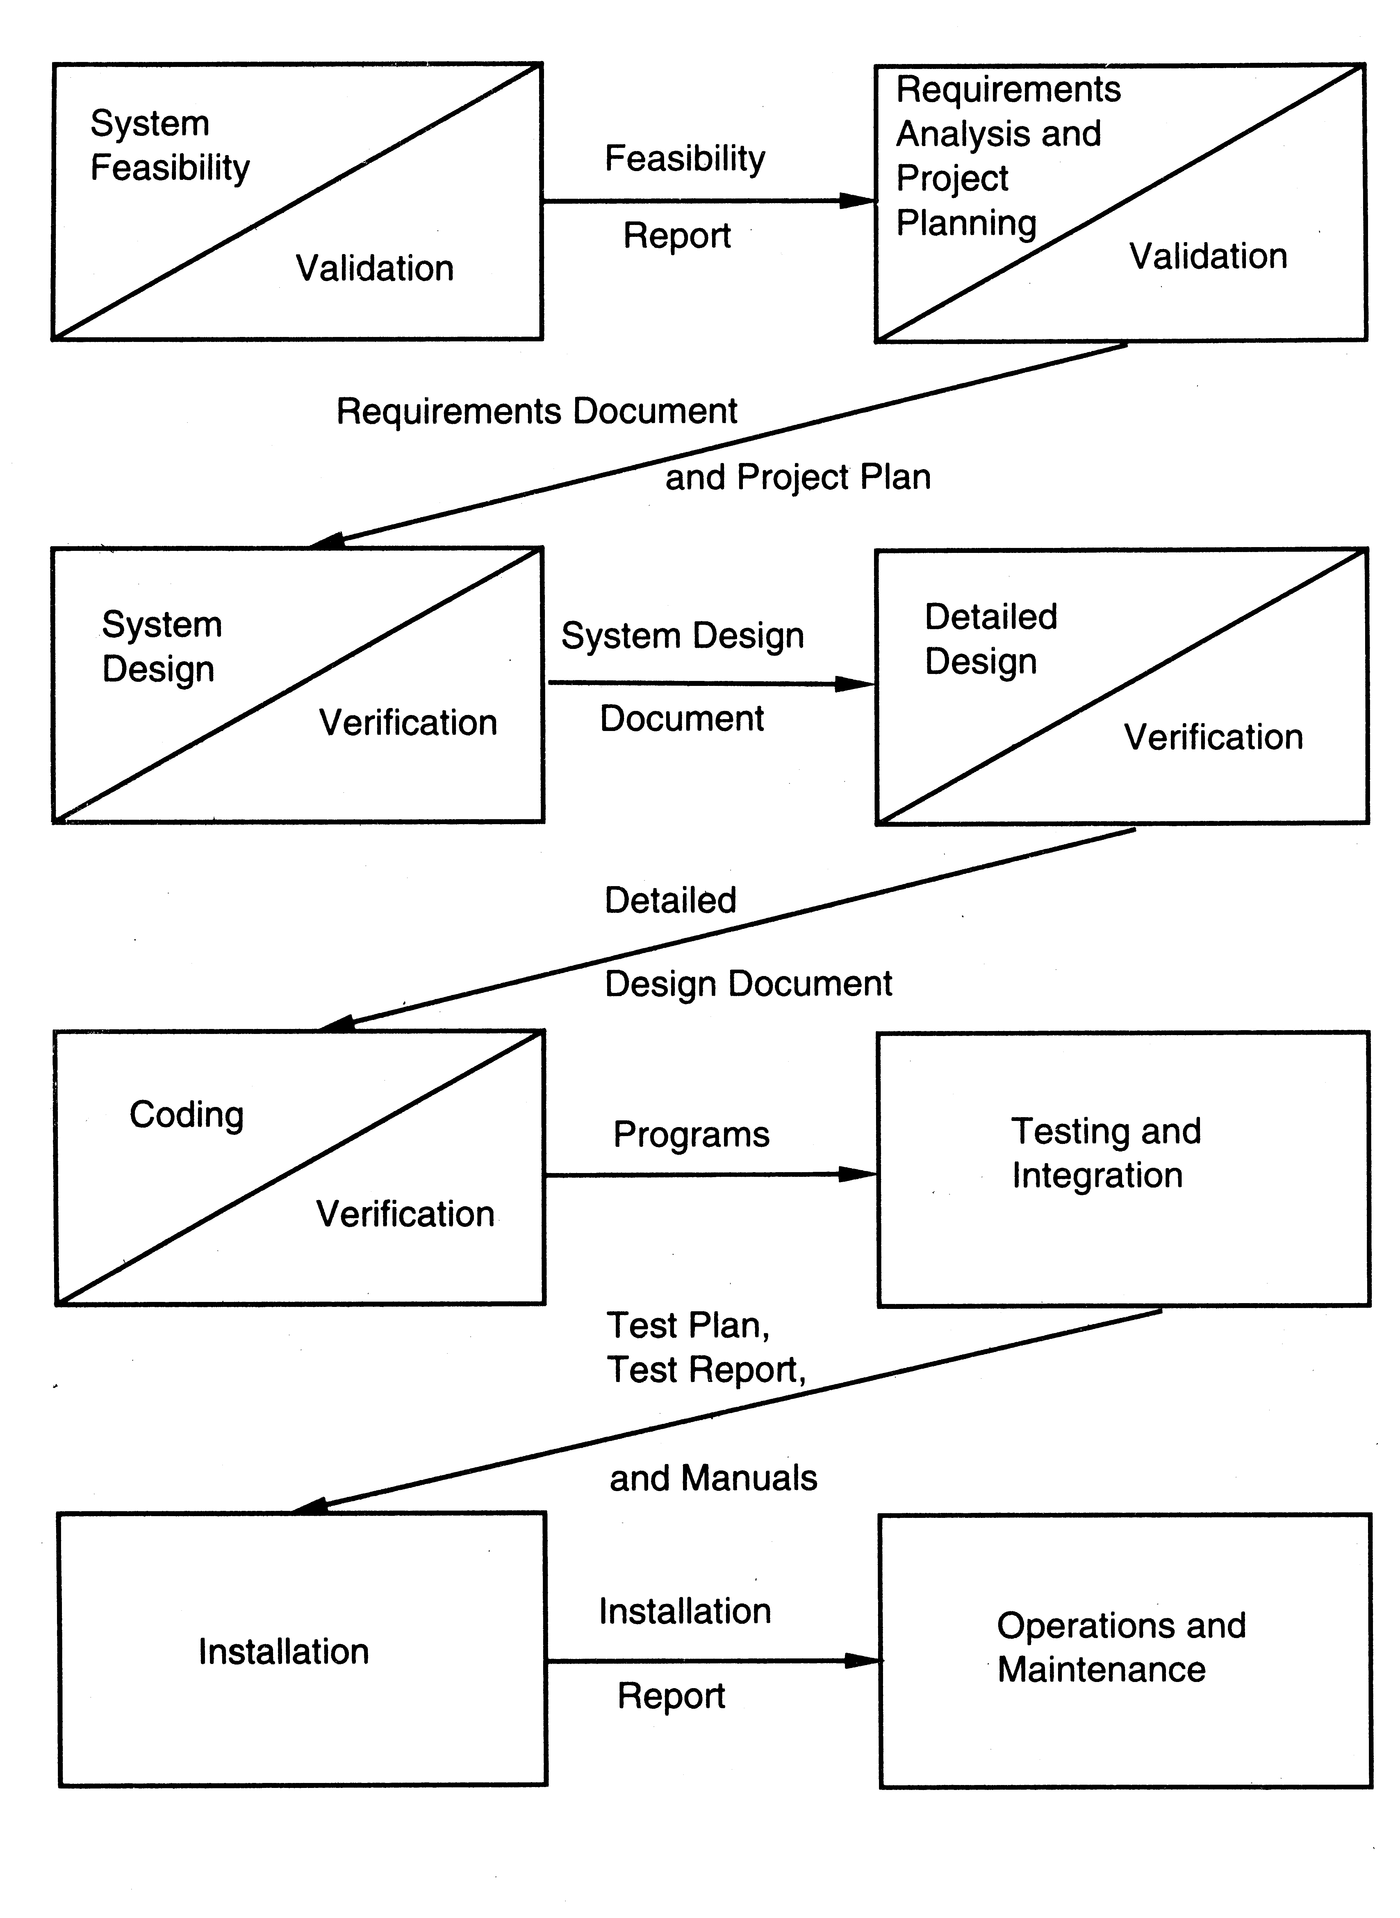
Classical Waterfall Model
Information System Design
Notes:
Lecture# 19
24/10/2007
IT60105: D. Samanta, SIT, IIT Kharagpur

Slide 8
Classical Waterfall Model
The classical waterfall model is elegant and intuitively the most obvious way to develop system
The model is considered to be theoretical way of developing system
Rather the model is not practical
Other life cycle models are essentially derived from the classical waterfall model
Information System Design
Notes:
Lecture# 19
24/10/2007
IT60105: D. Samanta, SIT, IIT Kharagpur

Slide 9
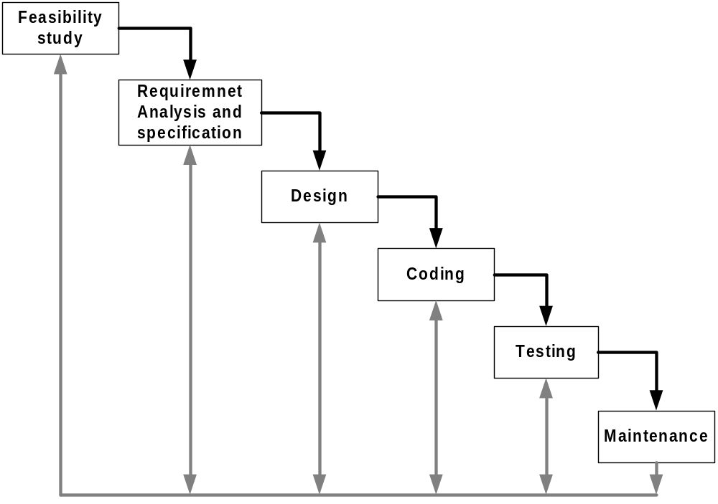
Iterative Waterfall Model
Information System Design
Notes:
Lecture# 19
24/10/2007
IT60105: D. Samanta, SIT, IIT Kharagpur

Slide 10
Iterative Waterfall Model
Advantages:
  Iterative waterfall model is practical compared to the classical waterfall model since errors are taken into consideration in it
Drawbacks
  It unable to handle different risks that a real-life software project is subjected to
  It follows rigid phase sequence, but for higher productivity and better efficiency it may not be desirable at all
  The model is suitable for well-understood problem, not suitable for very large projects
Information System Design
Notes:
Lecture# 19
24/10/2007
IT60105: D. Samanta, SIT, IIT Kharagpur

Slide 11
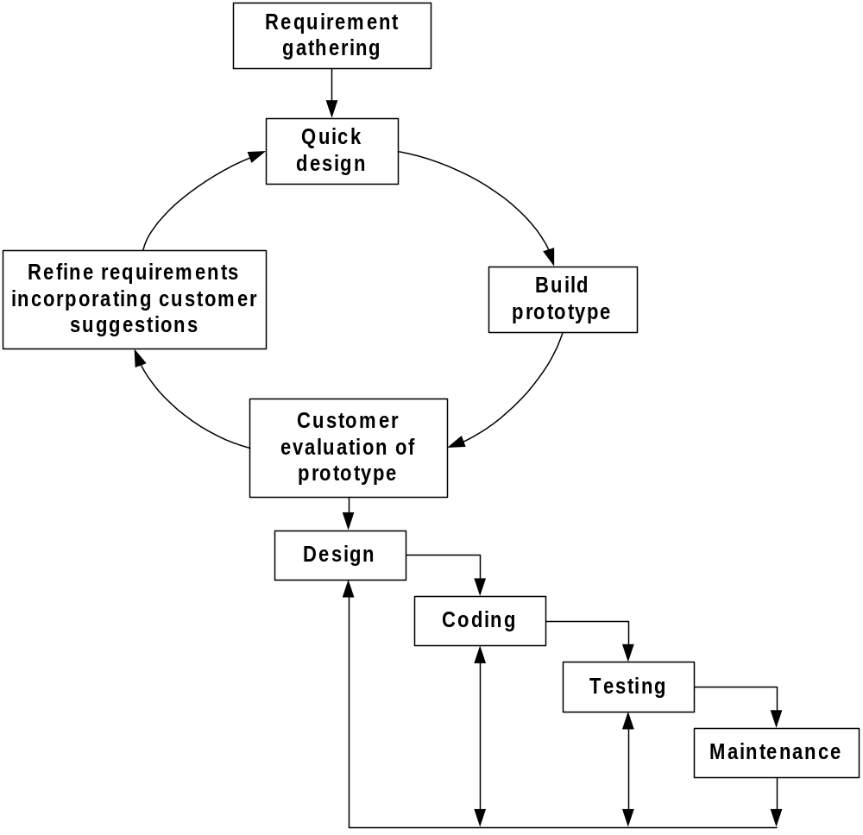
Prototyping Model
Information System Design
Notes:
Lecture# 19
24/10/2007
IT60105: D. Samanta, SIT, IIT Kharagpur

Slide 12
Prototyping Model
Expensive but deal with more complex and new system development (unlike waterfall model)
Many customer requirements get properly defined
Technical issues get resolved by experimenting with the prototype
Minimizes the redesign costs
Information System Design
Notes:
Lecture# 19
24/10/2007
IT60105: D. Samanta, SIT, IIT Kharagpur

Slide 13
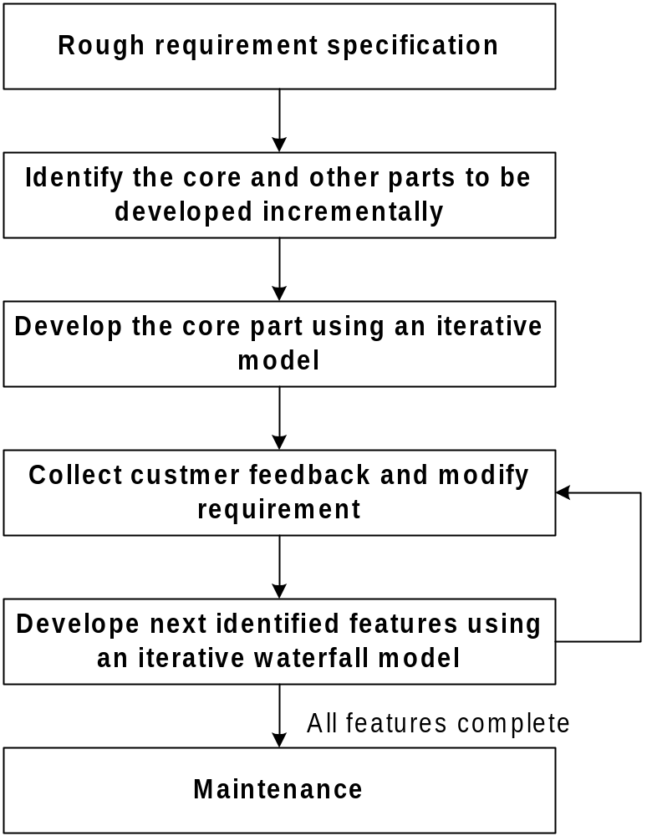
Evolutionary Model
Information System Design
Notes:
Lecture# 19
24/10/2007
IT60105: D. Samanta, SIT, IIT Kharagpur

Slide 14
Evolutionary Model
This model is based on the incremental approach
User gets a chance to experiment with a partially developed system much before the complete version
Minimum redesign effort
Obviate the need to commit large resources in one go
Suitable for very large system development
Information System Design
Notes:
Lecture# 19
24/10/2007
IT60105: D. Samanta, SIT, IIT Kharagpur

Slide 15
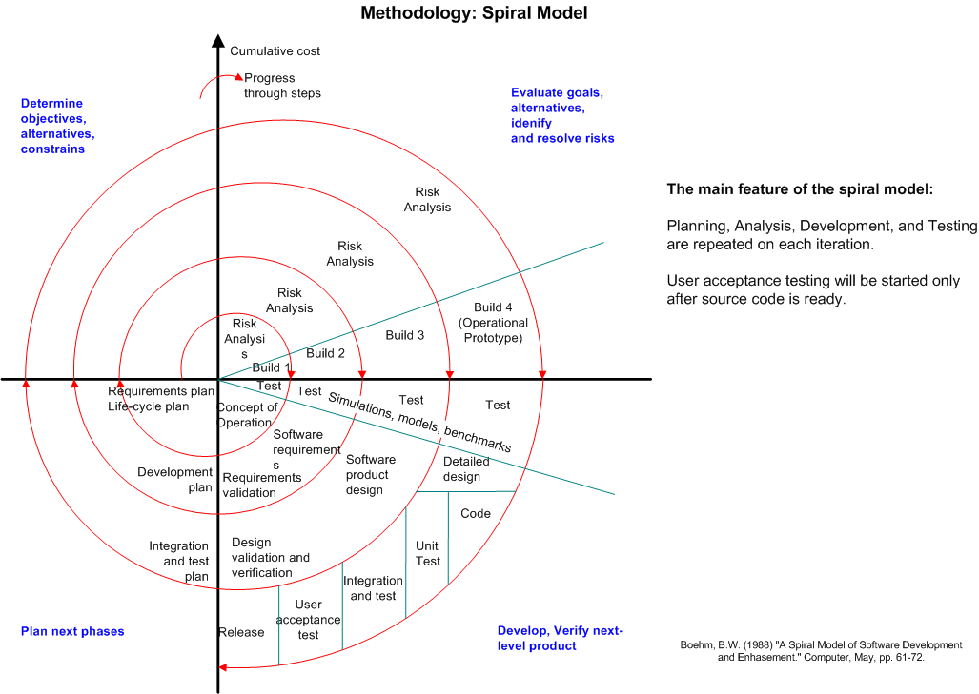
Spiral Model
Information System Design
Notes:
Lecture# 19
24/10/2007
IT60105: D. Samanta, SIT, IIT Kharagpur

Slide 16
Spiral Model
Spiral model is also termed as meta model, since it subsumes all the previously discussed models
Unlike other models, it provides good insight to the project risks
Spiral model is much more flexible compared to other models
Models looks like a spiral with many loops
The number of loops is not fixed rather decided by
  Number of phases
  Iteration of the phases
Exact number of phases and order of phases is not fixed hence the model is more flexible
There are four stages of each phase, which is depicted by four sectors in the model
As a loop proceeds, a more complete version of the system gets build
  Radius of spiral at any point represents the cost incurred in the project till then
  Angular dimension represents the progress made in the current phase
Information System Design
Notes:
Lecture# 19
24/10/2007
IT60105: D. Samanta, SIT, IIT Kharagpur

Slide 17
Time-boxing
It has linear sequence of iterations. Each iteration is a mini waterfall – decide the specifications, then plan the iteration
Time boxing – fix an iteration duration, then determine the specifications
Divide iteration in a few equal stages
Use pipelining concepts to execute iterations in parallel
In time boxed iterations – fix the duration of iteration and adjust the functionality to fit it
Completion time is fixed, the functionality to be delivered is flexible
Development is done iteratively in fixed duration time boxes
Each time box divided in fixed stages
Each stage performs a clearly defined task that can be done independently
There is a dedicated team for each stage
When one stage team finishes, it hands over the project to the next team
Information System Design
Notes:
Lecture# 19
24/10/2007
IT60105: D. Samanta, SIT, IIT Kharagpur

Slide 18
Time-boxing: Example
An iteration with three stages – Analysis, Build, Deploy
  These stages are appx equal in many situations
  Can adjust durations by determining the boudaries suitably
  Can adjust duration by adjusting the team size for each stage
Have separate teams for A, B, and D
Pipelined Execution
  AT starts executing it-1
  AT finishes, hands over it-1 to BT, starts executing it-2
  AT finishes it-2, hands over to BT; BT finishes it-1, hands over to DT; AT starts it-3, BT starts it-2 (and DT, it-1)
Information System Design
Notes:
Lecture# 19
24/10/2007
IT60105: D. Samanta, SIT, IIT Kharagpur

Slide 19
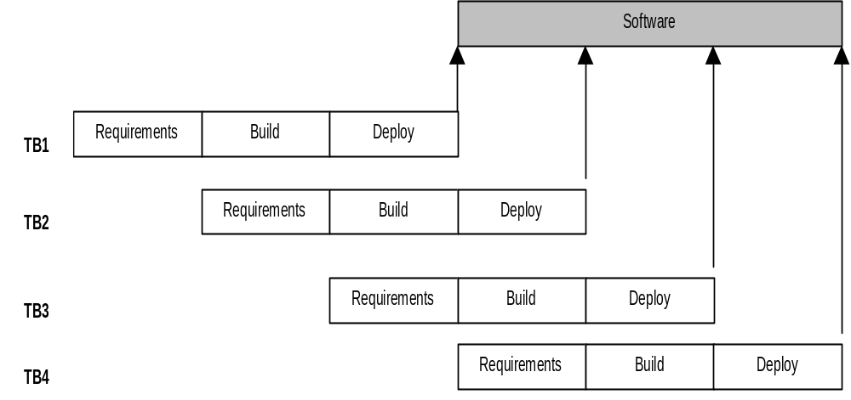
Time-boxing execution
Information System Design
Notes:
Lecture# 19
24/10/2007
IT60105: D. Samanta, SIT, IIT Kharagpur

Slide 20
Time-boxing execution
First iteration finishes at time T
Second finishes at T+T/3; third at T+2 T/3, and so on
In steady state, delivery every T/3 time
If T is 3 weeks, first delivery after 3 wks, 2nd after 4 wks, 3rd after 5 wks,…
In linear execution, delivery times will be 3 wks, 6 wks, 9 wks,…
Duration of each iteration still the same
Total work done in a time box is also the same
Productivity of a time box is same
Yet, average cycle time or delivery time has reduced to a third
Information System Design
Notes:
Lecture# 19
24/10/2007
IT60105: D. Samanta, SIT, IIT Kharagpur

Slide 21
Time-boxing: Team Size
In linear execution of iterations, the same team performs all stages
If each stage has a team of S, in linear execution the team size is S
In pipelined execution, the team size is three times (one for each stage)
I.e. the total team size in time-boxing is larger; and this reduces cycle time
Merely by increasing the team size we cannot reduce cycle time - Brook’s law
Time-boxing allows structured way to add manpower to reduce cycle time
Note that we cannot change the time of an iteration – Brook’s law still holds
Work allocation different to allow larger team to function properly
Information System Design
Notes:
Lecture# 19
24/10/2007
IT60105: D. Samanta, SIT, IIT Kharagpur

Slide 22
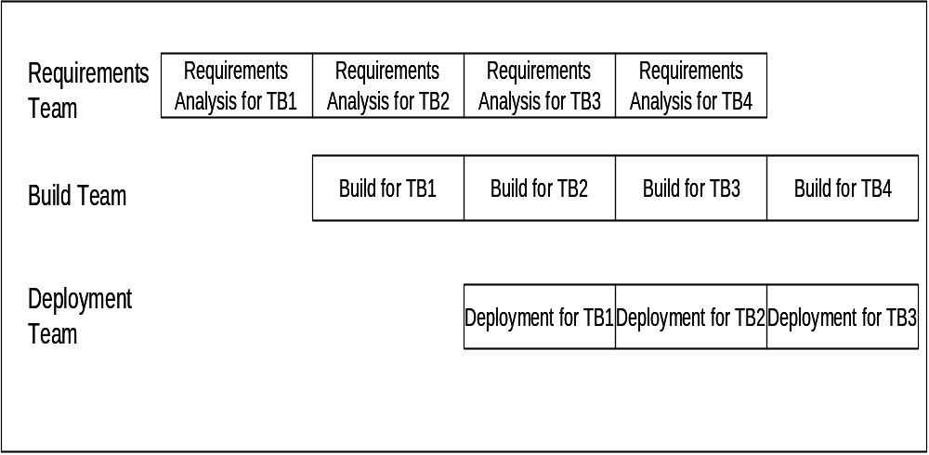
Time-boxing: Work Allocation of Teams
Information System Design
Notes:
Lecture# 19
24/10/2007
IT60105: D. Samanta, SIT, IIT Kharagpur

Slide 23
Time-boxing
Advantages:
  Shortened delivery times, other advantage is iterative, distributed execution.
Disadvantages:
  Larger teams, project management is harder, high synchronization needed, Configuration management is harder.
Applicability:
  When short delivery times is very important, architecture is stable; flexibility in feature grouping.
Information System Design
Notes:
Lecture# 19
24/10/2007
IT60105: D. Samanta, SIT, IIT Kharagpur

Slide 24
Rapid Application Development
It is an objective-oriented approach to system development
RAD and Prototyping are conceptually very close
Goal of RAD is to shorten the time typically needed in a traditional SDLC
There are three phases in RAD
  Requirement planning
  Design
  Implementation
Information System Design
Notes:
Lecture# 19
24/10/2007
IT60105: D. Samanta, SIT, IIT Kharagpur

Slide 25
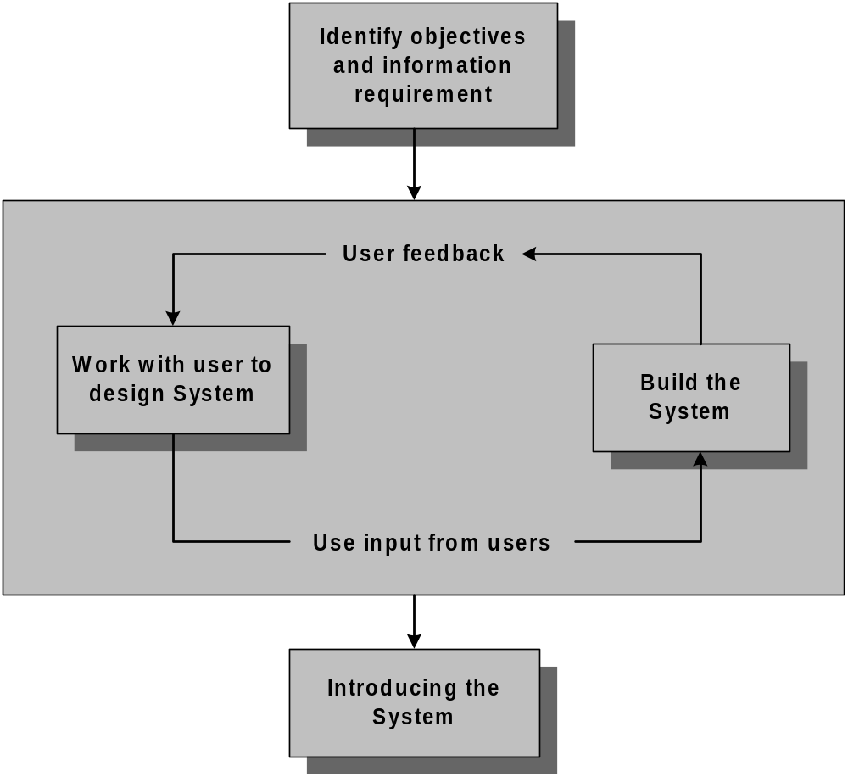
Rapid Application Development
Information System Design
Notes:
Lecture# 19
24/10/2007
IT60105: D. Samanta, SIT, IIT Kharagpur

Slide 26
Rapid Application Development
Advantages
  Useful for inexperienced team
  Pressing business for speeding up the system development
  Working with novel system development
  Developing system for sophisticated users
  RAD can be merged with SDLC
Disadvantages
  Not a systematic approach
  Hardly bother about system documentation
  Time vs. Attention trade-off
Information System Design
Notes:
Lecture# 19
24/10/2007
IT60105: D. Samanta, SIT, IIT Kharagpur

Slide 27
Component-Based Software Engineering
In majority of the software project there is some software reuse
  Components which are readily available to a team can be modified them as needed and incorporated them into their system
  Reuse is often essential for rapid system development
CBSE is a reuse-oriented approach
  It follows a large base of reusable software components and some integrating framework for these components
  These components are called COTS (Commercial Off-The-Shelf)
Information System Design
Notes:
Lecture# 19
24/10/2007
IT60105: D. Samanta, SIT, IIT Kharagpur

Slide 28
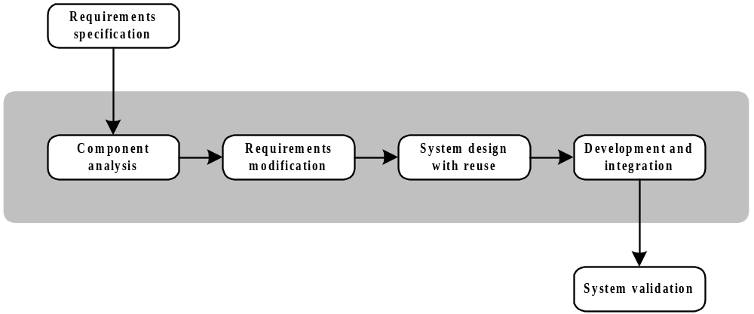
Generic Process Model of CBSE
Information System Design
Notes:
Lecture# 19
24/10/2007
IT60105: D. Samanta, SIT, IIT Kharagpur

Slide 29
Component-Based Software Engineering
Advantages
  Reduces the amount of software to be developed
  Reduces the cost of development
  Reduces risk
Disadvantages
  Requirement compromises are inevitable
  May lead to a system that does not meet the real needs of users
  Control over the system evolution is lost as the new versions of the reusable components are not under the control of the project group
Information System Design
Notes:
Lecture# 19
24/10/2007
IT60105: D. Samanta, SIT, IIT Kharagpur

Slide 30
Agile Software Development
Weakness of traditional development:
  Hardly bother about system documentation
  Time vs. Attention trade-off
  Miscommunication
  Redesign is problematic
  Back traversing is not allowed
  Can cause systems to be left unfinished and/or implemented before they are ready.
Agile software development is a group of software development methods based on iterative and incremental development.
It uses where requirements and solutions evolve through collaboration between self-organizing, cross-functional teams.
It promotes adaptive planning, evolutionary development and delivery, a time-boxed iterative approach, and encourages rapid and flexible response to change.
Information System Design

Slide 31
Agile Software Development
It is driven by customer descriptions of what is required (scenarios)
Recognizes that plans are short-lived
Develops software iteratively with a heavy emphasis on construction activities
Delivers multiple ‘software increments’
Adapts as changes occur
Effective (rapid and adaptive) response to change
Effective communication among all stakeholders
Drawing the customer onto the team
Organizing a team so that it is in control of the work performed
Information System Design

Slide 32
Agile manifesto
“We are uncovering better ways of developing software by doing it and helping others do it. Through this work we have come to value:
  Individuals and interactions over processes and tools
  Working software over comprehensive documentation
  Customer collaboration over contract negotiation
  Responding to change over following a plan
That is, while there is value in the items on the right, we value the items on the left more.”
Information System Design

Slide 33
Agile process models
Extreme Programming (XP)
Adaptive Software Development (ASD)
Feature-Driven Development (FDD)
Model-Driven Development (MDD)
Crystal Methods
Information System Design

Slide 34

Extreme Programming (XP) practices
Information System Design

Slide 35
RUP process model
The Rational Unified Process (RUP) is a use-case driven, architecture-centric, iterative and incremental process model.
The RUP focuses on creating and maintaining models rather than documentation. It is derived from Unified Modeling Language (UML)
The RUP divides the development cycle into four consecutive phases, namely; inception, elaboration, construction and transition.
Information System Design

Slide 36
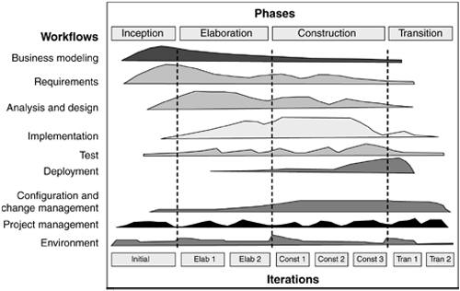
RUP process model
Information System Design

Slide 37
RUP process model
Inception phase establishes the business case for the system and delimit the project scope.
Elaboration phase analyzes the problem domain, establish an architectural framework, develop the project plan, and eliminate the highest risk elements of the project.
Construction phase focuses on development, integration and testing.
Transition phase moves the software product to the user community for working.
Information System Design

Slide 38
Exercises
Discuss the applications of each development model? List at least five examples of each?
Arrange the life cycle models in order according to development time, redesign time (customer satisfaction), problem size and the cost.
Classify the development models between iterative and non-iterative development.
Suppose that the stages in a time box in the time-boxing model are unequal. What will be the impact on delivery time and resource utilization?
Identify five component repository, which are used in different application areas of development.
Why RAD is suitable for object-oriented system development?
Compare traditional and agile process models. What are the differences and similarities among them.
Information System Design
Notes:
Lecture# 19
24/10/2007
IT60105: D. Samanta, SIT, IIT Kharagpur

